Slide 1
Air Quality and Respiratory Health
Chechen Yu
Erica Rosa
Joseph Moravitz
Shweta Shalini
Ted Stagner
Notes:
California data is pushed
Ttests.prevalence rates – not significant
Next steps:
User input
Counties gmaps

Slide 2
Background
Air Quality Index | (AQI) Values | Levels of Health Concern
When the AQI is in this range: | ..air quality conditions are:
0 to 50 | Good
51 to 100 | Moderate
101 to 150 | Unhealthy for Sensitive Groups
151 to 200 | Unhealthy
201 to 300 | Very Unhealthy
301 to 500 | Hazardous
100
300
500
200
400
National Standard: <100
Particulate Matter
Ozone
NO2
CO
SO2
Project purpose: characterizing air quality in Georgia and exploring any potential relationships with asthma / respiratory health.
Notes:
EPA calculates the AQI for five major air pollutants regulated by the Clean Air Act: ground-level ozone, particle pollution (also known as particulate matter), carbon monoxide, sulfur dioxide, and nitrogen dioxide.
Think of the AQI as a yardstick that runs from 0 to 500. The higher the AQI value, the greater the level of air pollution and the greater the health concern.
https://cfpub.epa.gov/airnow/index.cfm?action=aqibasics.aqi

Slide 3
Data and Methods
Data
Methods
EPA AirNow Database
CDC Behavioral Risk Factor Surveillance System (BRFSS)
GA OASIS Asthma Data
Google Maps API
Data munging via Pandas
Plotting via Matplotlib
Statistical analysis via scipy
Geocoding/mapping via gmaps

Slide 4
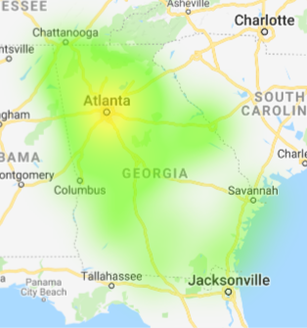
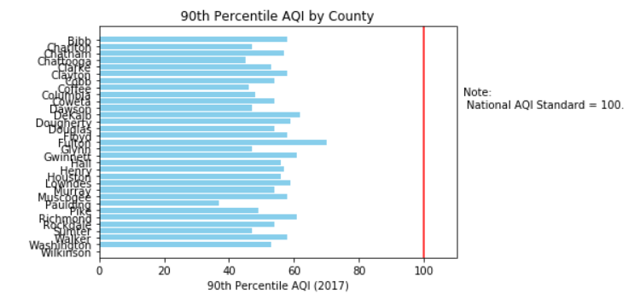
Georgia | By County (2017)
Notes:
% of GA counties where air quality does not meet national standards by year

Slide 5
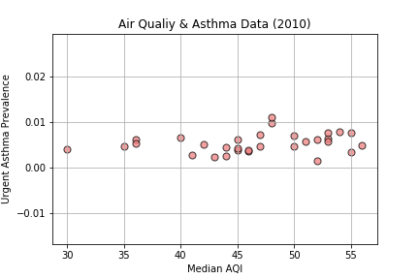
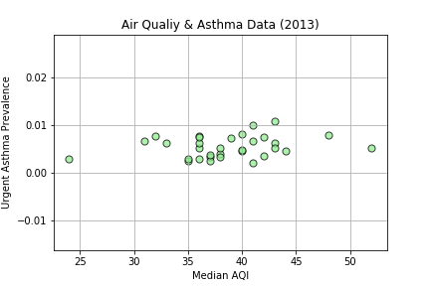
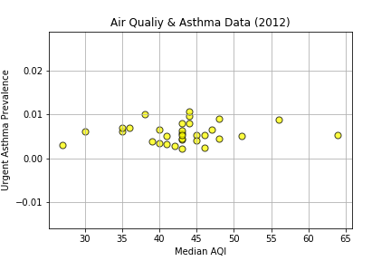
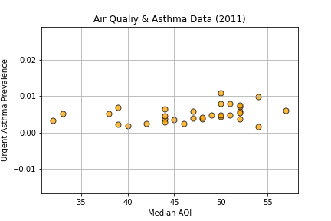
Georgia | By County
Notes:
Asthma prevalence scatter plots by year

Slide 6
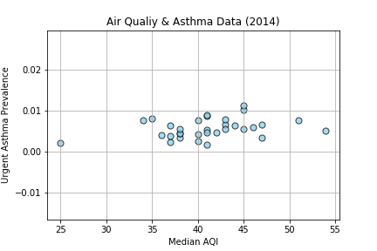
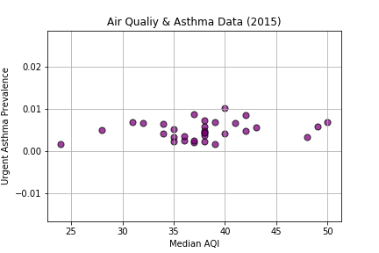
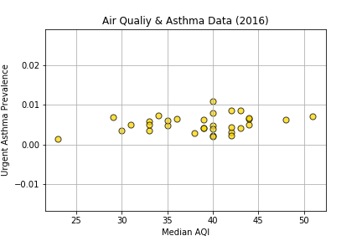
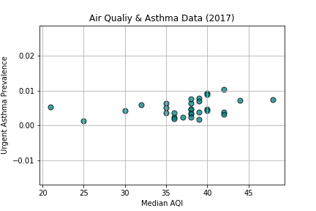
Georgia | By County

Slide 7
A Closer Look at Childhood Asthma

Slide 8
Georgia | By County Type
Add images that are most insightful
Notes:
Urban / rural stats - # good days ratio
Ttest median AQI between urb / rural – significant

Slide 9
Georgia | By County Type
Add images that are most insightful
Notes:
Urban / rural stats - # good days ratio
Ttest median AQI between urb / rural – significant

Slide 10
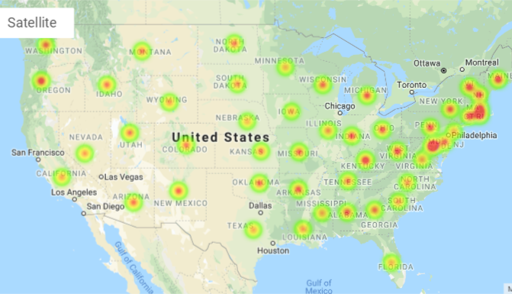
Asthma Prevalence by State
Notes:
https://www.cdc.gov/asthma/most_recent_data_states.htm
Try to locate state/city data for air quality

Slide 11
Observations
Notes:
Asthma is more of a chronic condition than acute.
Many factors will contribute to ER visit for an asthma emergency.
Those with high sensitivity to air pollutants may be aware of air quality and take precautions

Slide 12
Limitations / Assumptions

Slide 13
User Input Demo
Jupyter Notebook

Slide 14
THANK YOU!
Any questions?

